Slide 1

Drexel and FMFCU
www.fmfcu.org/drexel
Presented By
Notes:
1

Slide 2
Identity Theft & Fraud
Presented By
Notes:
1

Slide 3
Identity Theft & Fraud
Don’t Be The Next Victim!
Presented By
Notes:
1

Slide 4
What is Identity Theft?
Identity Theft & Fraud
Presented By
Notes:
1

Slide 5
Leading Generation Targeted
Federal Trade Commission data shows young adults, ages of 18 – 29, make up the largest percentage of identity theft victims.
"Their youth and the open, communal atmosphere of college life can make college kids more susceptible to identity theft, studies show," says Jennifer Leuer, senior vice president of Experian
"Many college students have little credit history, making them a preferred target for identity thieves."
Presented By
Notes:
1

Slide 6
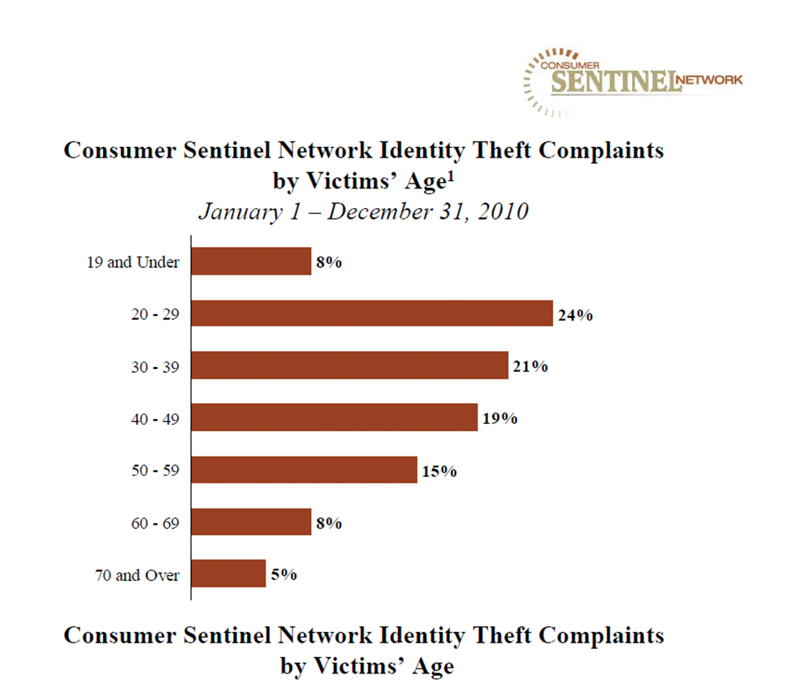

Who are the Victims?
Presented By
Notes:
1

Slide 7
How Does It Happen?
Stolen wallets/purses/records
Phishing
Stolen or diverted mail (home or work)
Dumpster diving
Pose as business or landlord to CRA
Internet hacking
Buy from inside sources
Presented By
Notes:
1

Slide 8
How Victim Information is
Misused?
Use existing credit account until
discovered
Empty bank account
Change address
Open new account in victim’s name
at different location
Presented By
Notes:
1

Slide 9
How Victim Information is
Misused?
Take out loans (especially auto) for
purchases
Establish phone or wireless account in
victim’s name at different location
Sell the information
Presented By
Notes:
1

Slide 10
Common Examples of Crimes Taking Place Today
Mail Fraud Scams
Family Members stealing information or
debit cards
eBay/Craigslist Scams
Account take-overs
Selling information
Presented By
Notes:
1

Slide 11
Consequences of ID Theft
Identity thieves NEVER pay bills for debts incurred under your name
You may not discover for months or years
You are then saddled with bad credit report
Due to bad credit report, you may be denied new credit, loans, mortgages, utility service, or employment
Presented By
Notes:
1

Slide 12
Consequences of ID Theft
Were criminal records created in your name?
You may fail background checks for employment, insurance, etc.
You may even spend time in jail!
Presented By
Notes:
1

Slide 13
Tips to Reduce Risk and Prevent ID Theft
Review your credit report annually with all three major credit bureaus.
      TransUnion
      Experian
      Equifax
Question unknown accounts or inquiries
Presented By
Notes:
1

Slide 14
Tips to Reduce Risk and Prevent ID Theft
Shred unnecessary financial documents
    Invoices
    Pre-approved credit offers
    Financial statements
    Anything with SSN
    Unused checks or credit cards
Presented By
Notes:
1

Slide 15
Tips to Reduce Risk and Prevent ID Theft
Close unused or unneeded credit card or line of credit accounts.
Consolidate accounts as much as possible to make monitoring easier
Monitor incoming mail for regular bills and statements
      If you notice expected financial statements are not reaching you, act immediately
Presented By
Notes:
1

Slide 16
Tips to Reduce Risk and Prevent ID Theft
Retrieve and review mail regularly
Ensure mail is picked up or stopped when you are away
Deposit outgoing mail in official United States Postal Service Drop Boxes Only
Do not leave mail in unsecured boxes for pickup
      Question suspicious incoming phone calls
Presented By
Notes:
1

Slide 17
Tips to Reduce Risk and Prevent ID Theft
Secure and guard computers used to access financial information
Don’t write down or share passwords, PINS, etc.
Avoid use of common or easily guessed passwords
Presented By
Notes:
1

Slide 18
Tips to Reduce Risk and Prevent ID Theft
Question suspicious email, online, or phone inquiries.
Unless you initiated the contact and are certain who you’re dealing with, don’t share personal identifiers or financial information.
Presented By
Notes:
1

Slide 19
What Should Victims Do?
Report To Local Police
  Get a copy of the report (Be Persistent)
Contact Local Creditors Fraud Departments
  Report fraudulent accounts and charges
Presented By
Notes:
1

Slide 20
Next Steps for Victims
Notify each credit reporting agency of all of the inaccuracies on your credit reports.
Notify each creditor in writing about any compromised accounts.
Get creditors to provide you something in writing stating they have closed the accounts and absolved you of the fraudulent debts.
Presented By
Notes:
1

Slide 21
Credit Reporting Agencies
EQUIFAX………………….1-800-525-6285
EXPERIAN………………..1-888-397-3742
TRANSUNION…………..1-800-680-7289
Presented By
Notes:
1

Slide 22
Other Contacts . . .
Postal Inspector
If you suspect mail fraud.
Utility Companies
Alert them to the possibility that someone may
attempt to establish new services using your
identification.
Department of Motor Vehicles
If your drivers license has been compromised
and/or used as identification on bad checks. Put
a fraud alert on your license.
Presented By
Notes:
1

Slide 23
If Checks are Stolen or Accounts Established Fraudulently
ChexSystems 1-800-428-9623
Scan 1-800-262-7771
CheckRite 1-800-766-2748
CrossCheck 1-800-552-1900
EquiFax 1-800-437-5120
National Processing Co. 1-800-526-5380
TeleCheck 1-800-710-9898
International Check
Services 1-800-631-9656
Presented By
Notes:
1

Slide 24
Useful Resources
Federal Trade Commission (FTC) You may get help from and file your case with the FTC Consumer Response Center.
1-877-IDTHEFT
http://www.ftc.gov/idtheft/
Presented By
Notes:
1

Slide 25
More Useful Resources
Privacy Rights Clearing House (PRC) Its website contains many publications on identity theft.
1-619-298-3396
http://www.privacyrights.org
Identity Theft Survival Kit
1-800-725-0807
http://www.identitytheft.org
Presented By
Notes:
1

Slide 26
Questions?
More Information: www.fmfcu.org/drexel
Presented By
Notes:
1

